Slide 1
DSAA 2022 Spring
Welcome Lab
计算机科学与工程系 程然 chengr@sustech.edu.cn

Slide 2

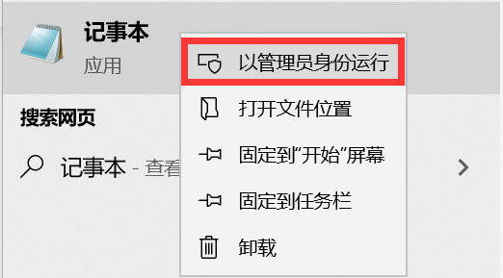
How to use OJ
0.If you are not using the campus network, you need to go through the following steps to access it.
Step1: Run the text editor as an administrator
(or Notepad, etc.)
Step2: Open C:\windows\system32\drivers\etc\hosts
(Linux: \etc\hosts)
Step3: Add the following line into the end of the file:
2001:da8:201d:1107::d2d7 oj.sustech.xyz

Slide 3
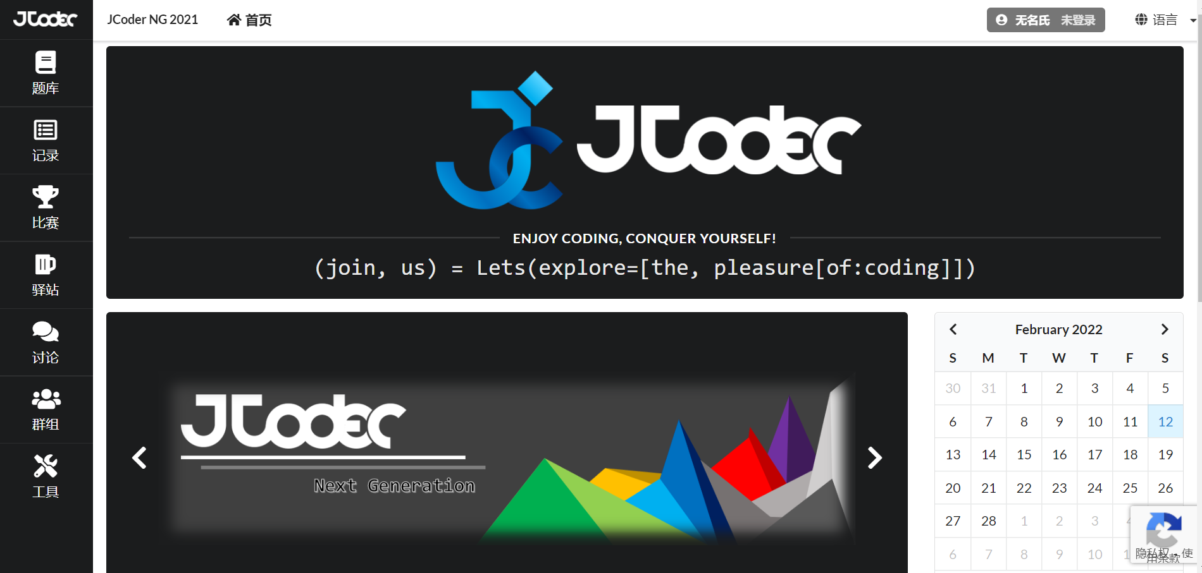

How to use OJ
1.Open OJ
http://oj.sustech.xyz/home
The system does not support IE browser. (Please use chrome or edge, etc.)
2. Login
Your account and initial password are your student ID. Please change your password as soon as possible after logging in. (没改密码前不要提交代码！)

Slide 4
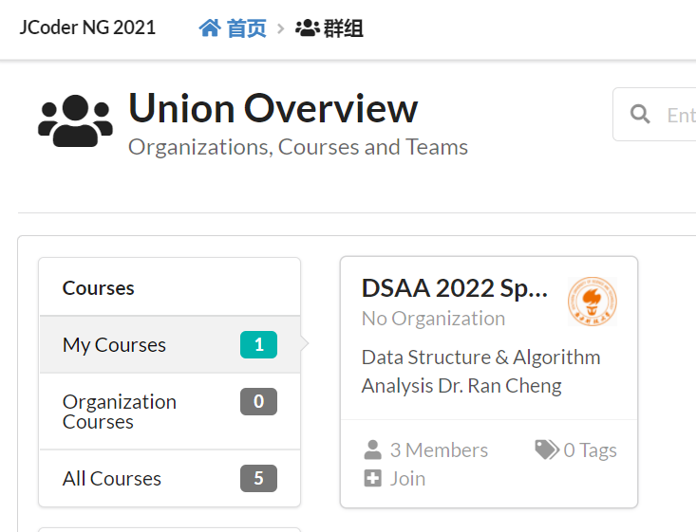
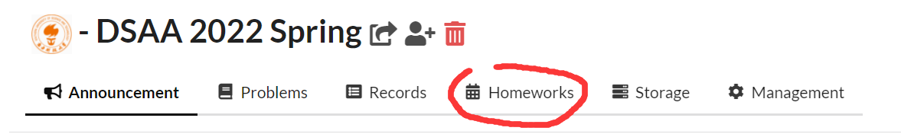


How to use OJ
3.Find your assignment
1.Click “群组” 2.Choose your course
3.Click “Homeworks”

Slide 5
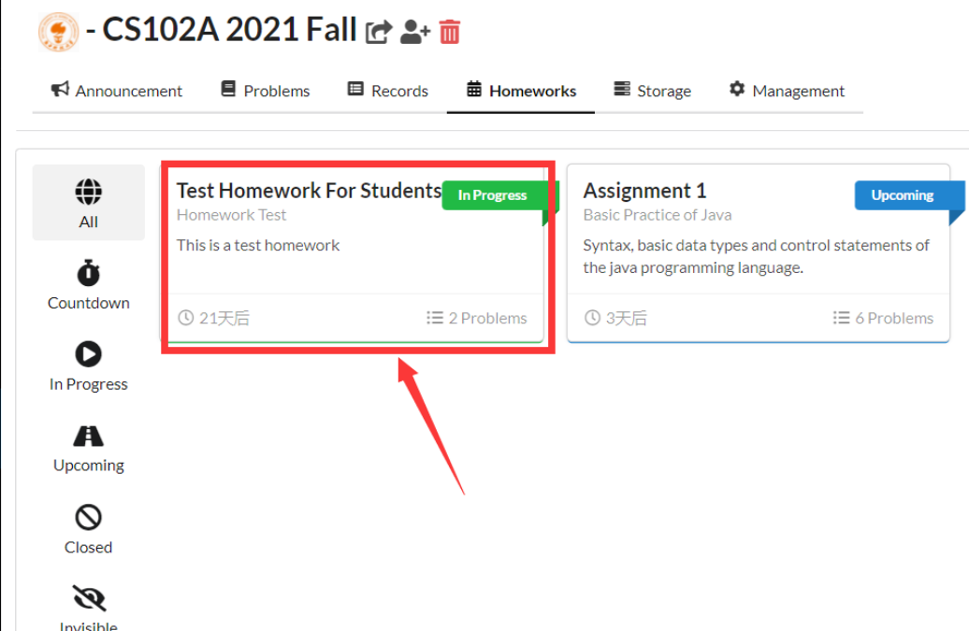
How to use OJ
4. Find the Assignment, you can test OJ by “Test Homework For Students”

Slide 6
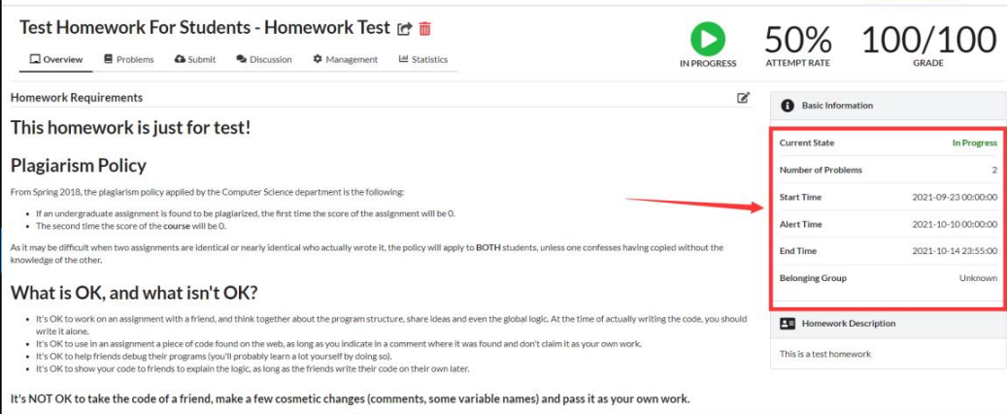
How to use OJ
5.Check the DEADLINE

Slide 7
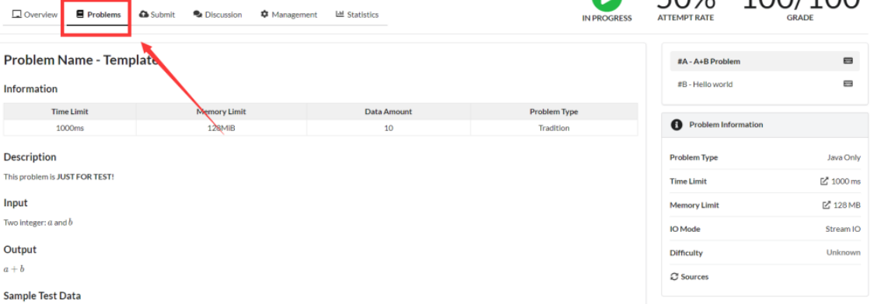
How to use OJ
4. Submit your code
1.Click “problems”

Slide 8
How to use OJ
4. Submit your code
2. Choose a problem

Slide 9
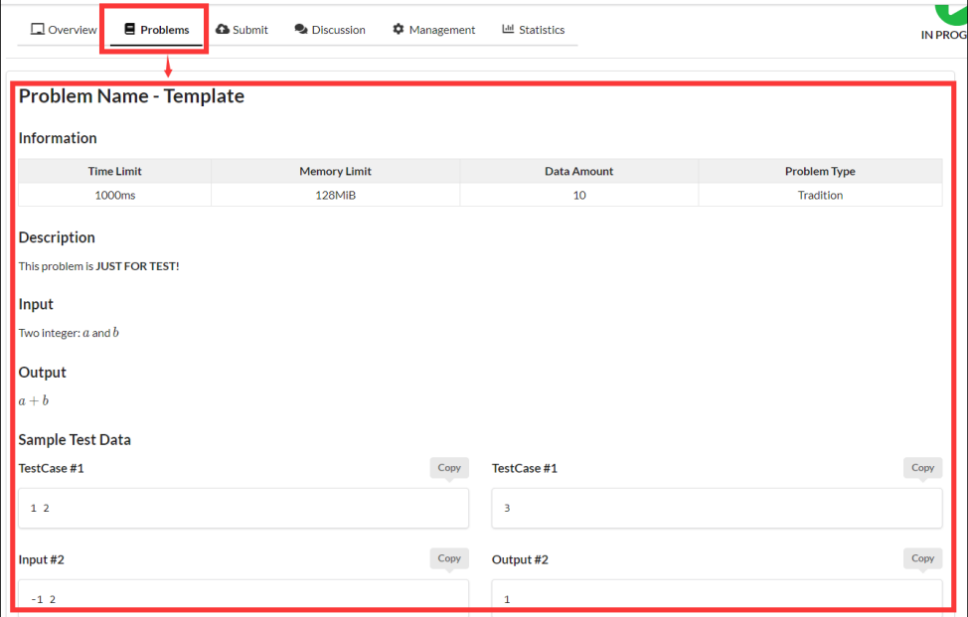
How to use OJ
4. Submit your code
3. Description for the problem is in “Problems”

Slide 10
How to use OJ
4. Submit your code
3. Description for the problem is in “Problems”

Slide 11
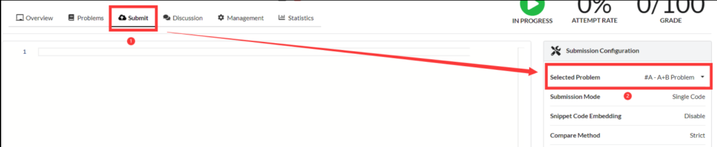
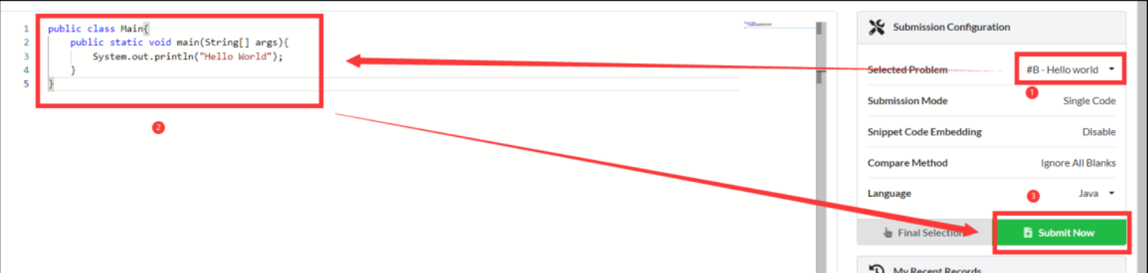
How to use OJ
4. Submit your code
4. Click “Submit” and choose the problem to submit your code.
5. Paste your code and click “Submit Now”
In OJ, your class name must be “Main”.

Slide 12
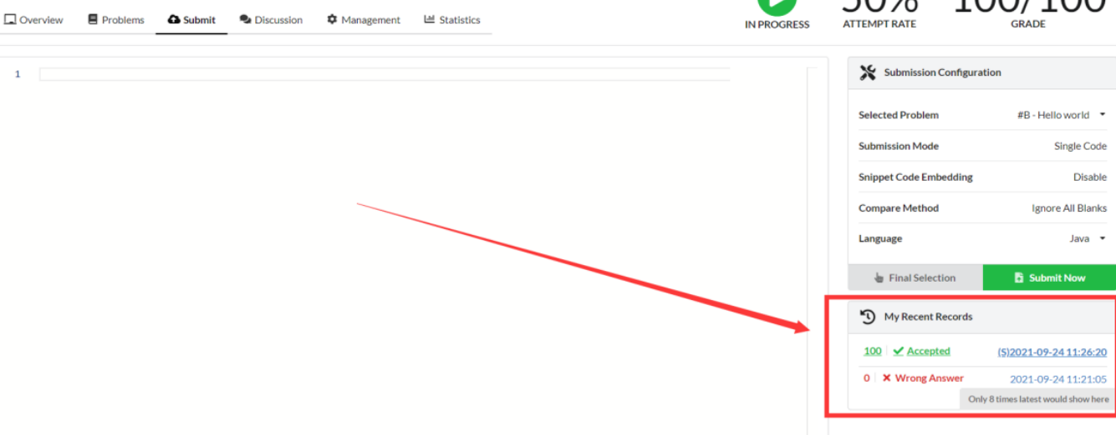
How to use OJ
5. View the result
1. You can see the result after submitted your code.

Slide 13
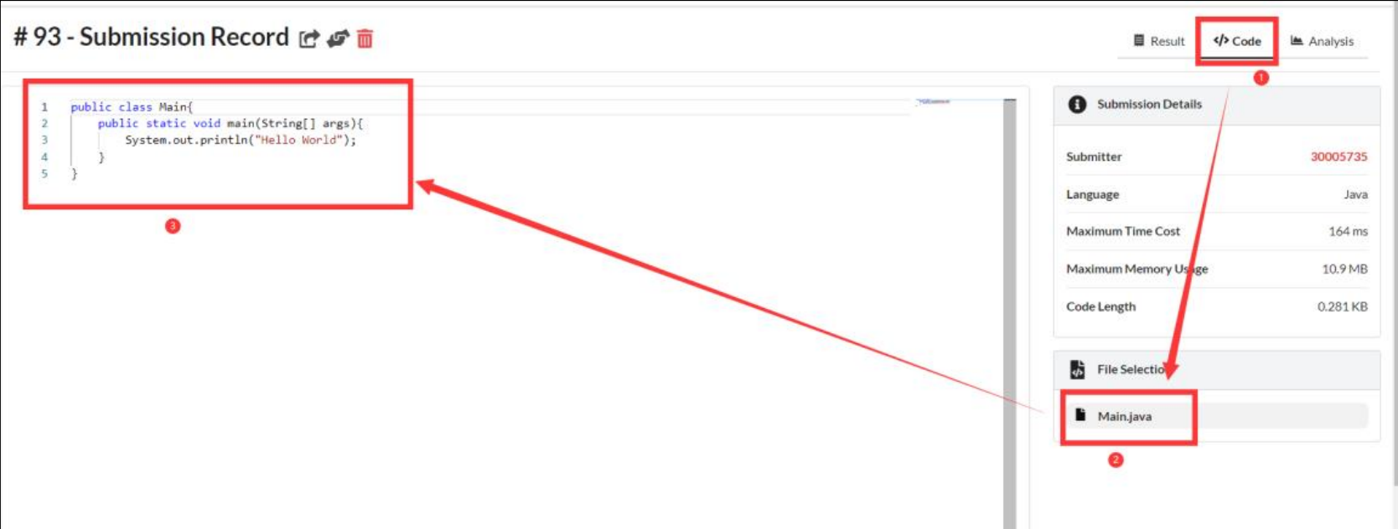
How to use OJ
5. View the result
2. You can see the code you submitted.

Slide 14
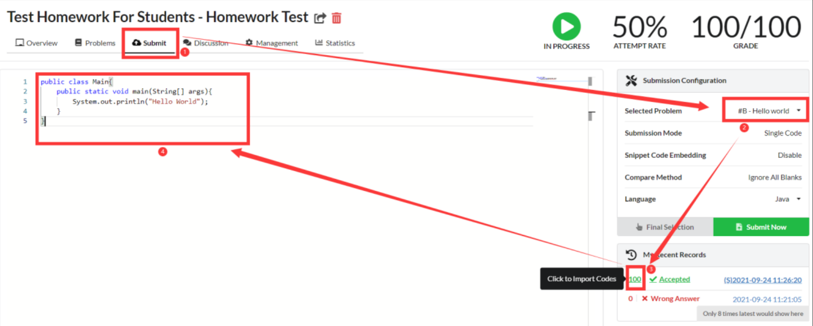
How to use OJ
5. View the result
3. You can modify your history code.

Slide 15
Thank you for your listening！

